Slide 1
DSA
Lecture#14

Slide 2
Bubble Sort
If we have n elements in an unsorted array, then ‘n-1’ Rounds(from Round#1 to Round#(n-1)) will be executed to sort them.
In Round#1, ‘n-1’ comparisons will be done.
In Round#2, ‘n-2’ comparisons will be done.
Similarly, in Round#(n-1), n-(n-1) means only one comparison will be done.

Slide 3

Bubble sort Example
Apply a bubble sort algorithm on the following array:

Slide 4
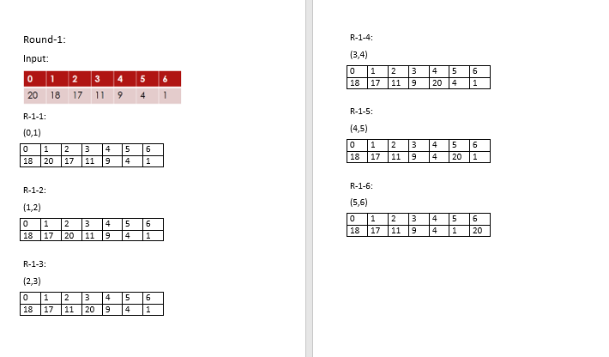
Cont…

Slide 5
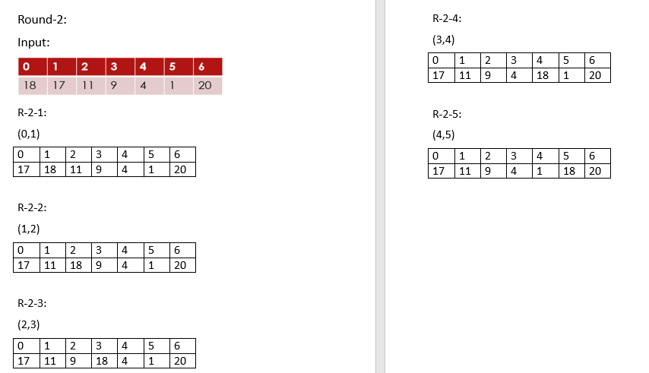
Cont…

Slide 6
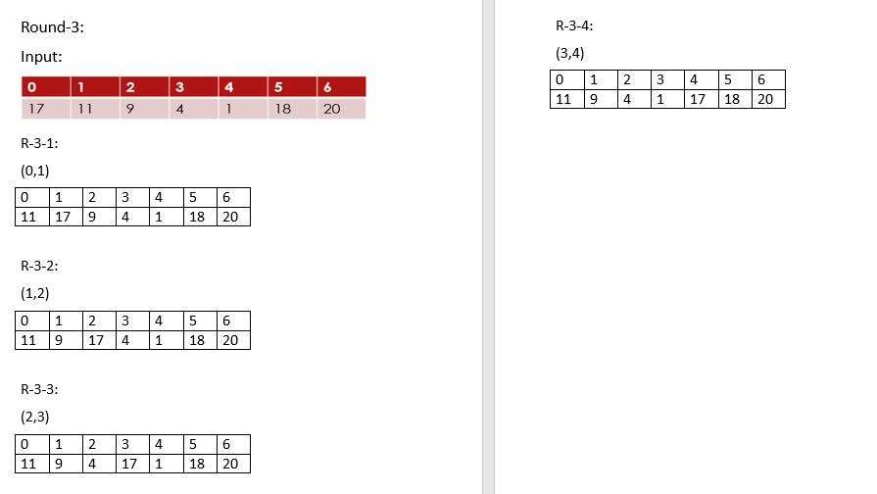
Cont…

Slide 7
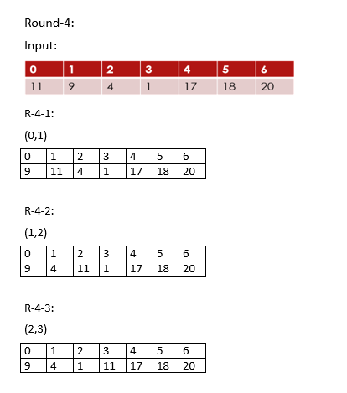
Cont…

Slide 8
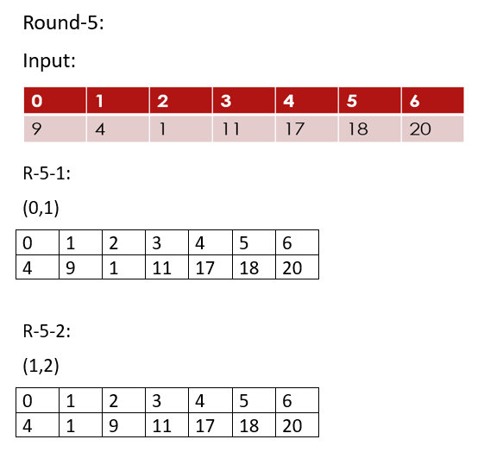
Cont…

Slide 9
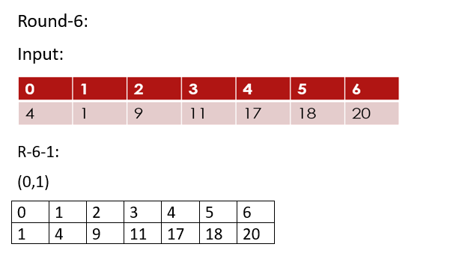
Cont…

Slide 10
Cont…
At the end of each round, the maximum value will be placed at the right side in the array.
In Round#1, the maximum value will be placed at the index#(n-1).
In Round#2, the second maximum value will be placed at the index#(n-2) and so on.

Slide 11
Selection Sort
If we have n elements in an unsorted array, then ‘n’ Rounds(from Round#1 to Round#(n)) will be required to sort them.
At the end of each round, the minimum value will be placed at the left side in the array.
In Round#1, the minimum value will be placed at the index#0.
In Round#2, the second minimum value will be placed at the index#1 and so on.
Placing each minimum value from the unsorted portion in any Round#k at position index#(k-1)

Slide 12
THANK
YOU

